Slide 1
Optimization of Photodetection Analysis for MXene Thin Films
Kristine Loh
MS Thesis Defense
May 21, 2020
Thesis Advisor: Prof. Jason Baxter
Committee Members: Prof. Yury Gogotsi | Prof. Steven May

Slide 2
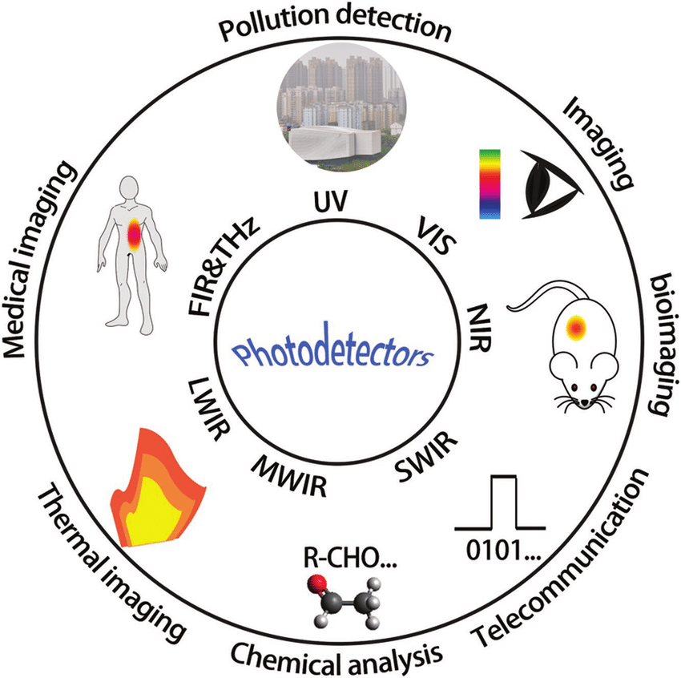
Photodetectors
Zhuge, F. et al. Advanced Materials Technologies (2017) doi:10.1002/admt.201700005
Notes:
-Photodetectors: convert optical signal to electric signal
-Type of light the photodetector can absorb determines the application

Slide 3
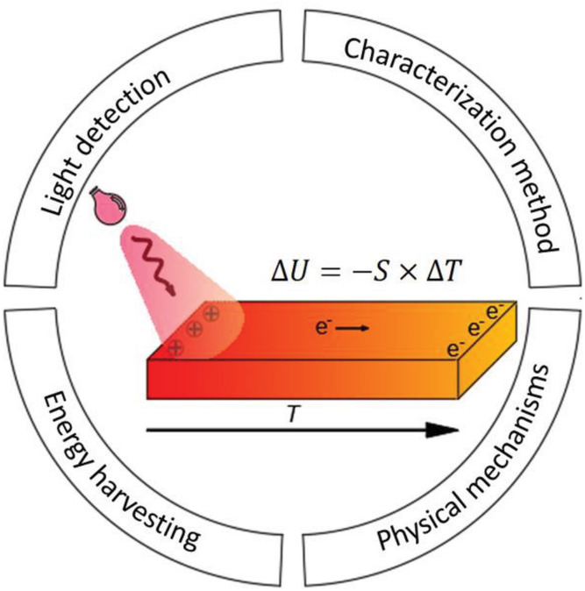
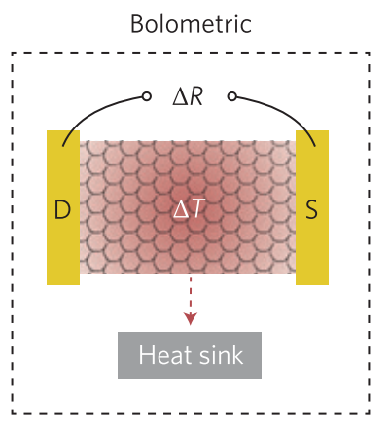
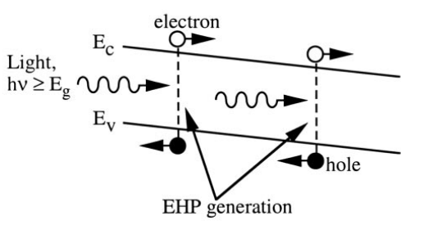
Mechanisms for Photodetection
Photovoltaic Effect
or
Photoconductive Effect
Photothermoelectric Effect
Bolometric Effect
Fay, P. Encycl. Mater. Sci. Technol. 6909–6923 (2001) doi:10.1016/B0-08-043152-6/01225-0.
Lu, X. et al. Adv. Mater. 31, 1902044 (2019).
Koppens, F. H. L. et al. Nat. Nanotechnol. 9, 780–793 (2014).
Notes:
-PV effect is similar to photoconductive effect, difference is the application of bias voltage

Slide 4
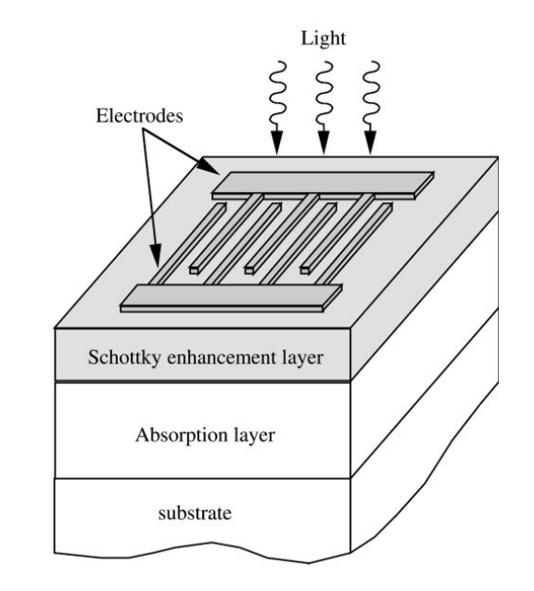
Photodetector Structures
Absorption layer
Typically made of semiconducting materials
Three main spectrum zones: ultraviolet (10 – 400 nm), visible (400 – 760 nm), and infrared (760 nm – 2.5 μm)
Electrical contacts (electrodes)
Typically made of metallic materials
Can be transparent depending on the structure
Fay, P. Encycl. Mater. Sci. Technol. 6909–6923 (2001) doi:10.1016/B0-08-043152-6/01225-0.
Notes:
-Contacts: where charge collection occurs
-Absorption layer: layer that depends on the mechanisms for photodetection

Slide 5
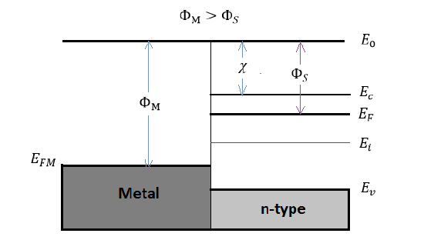
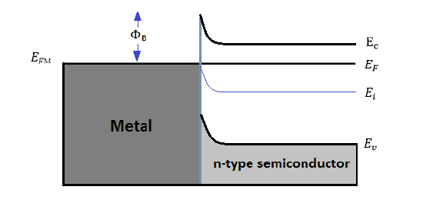
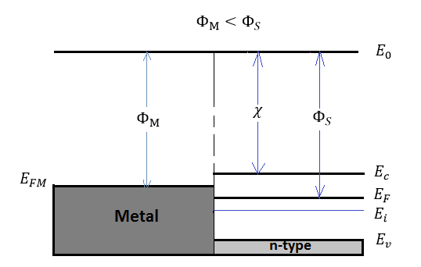
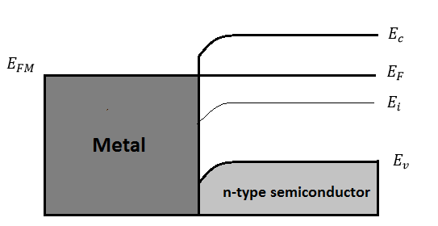
Contacts
Schottky (Rectifying) Contact
Ohmic Contact
Pierret, R. F. Semiconductor Device Fundamentals. 478–481 (Addison-Wesley, 1995).
Notes:
-Schottky forces current to flow in one direction
-Ohmic allows flow in both directions
-Contacts can impact photodetection parameters, such as noise, speed

Slide 6
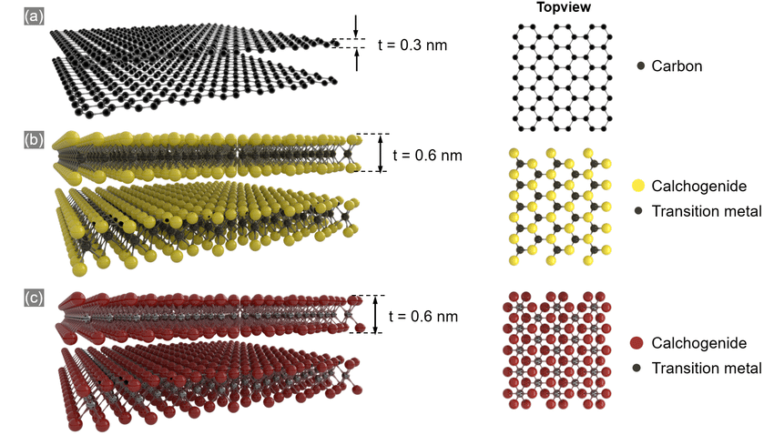
2D Materials for Photodetection
Ease of processing and desirable optoelectronic properties
Mechanical strength
Thickness tunable band gap
Examples:
Graphene
Transition metal dichalcogenides (TMDs) - MoS₂
Wagner, Stefan. (2018). doi: 10.18154/RWTH-2018-229791.
Notes:
-2D materials, or materials made of atomically thin nanosheets, have been used in photodetection applications
-TMD has a transition metal sandwiched by S or Se
-Graphene: not tunable, only C, no surface functional groups
-TMDs – no functional groups, not fully understood

Slide 7
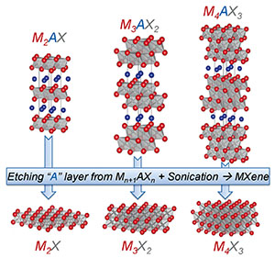
Introduction to MXenes
Discovered at Drexel University in 2011
Novel class of 2D materials
General formula of M­_{n+1}X_{n}T_{x}
M: early transition metal
X: either carbon or nitrogen
T: functional group
n is between 1 to 4
Tunable properties based on a variety of surface terminations and chemical compositions
M. Naguib, et al. Advanced Materials, 26.7 (2014): 992-1005.
Notes:
-Over 20 different MXenes have been reported and this class is still growing

Slide 8
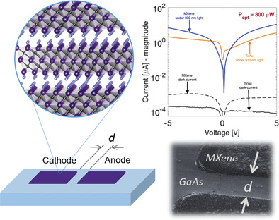
Why MXenes?
High electronic conductivity
Hydrophilic surface
Low cost
Facile synthesis methods
Tunable properties
Work function
Band structure
Montazeri, K. et al. Adv. Mater. 31, 1–9 (2019).
Notes:
-As mentioned earlier, high electronic conductivity is ideal for contacts to allow for better charge collection
-Conductivity: still conductive even when the material is very thin, refer to picture
-Hydrophilic surface: allows for solution processing, which is a scalable, low cost, and facile synthesis method
-Properties: work function, band structure,
-MXenes, particularly Ti3C2, have mostly been explored as electrical contacts
-They have been marginally explored for photodetection applications
-However, we still don’t really know why they behave the way they do
-My work aims to analyze these materials as both the electrical contact and the absorption layer

Slide 9
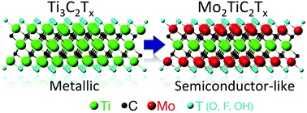
Why Ti₃C₂T_{x} and Mo₂TiC₂T_{x}?
Ti₃C₂T_{x} is heavily studied, but Mo₂TiC₂T_{x} is not
Will the same testing method apply to both materials?
Mo₂TiC₂T_{x} is semiconductor-like, can this be verified using this test method?
B. Anasori. et al. Nanoscale Horizons, 1 (2016): 227-234
Notes:
-As shown in the schematic, Ti3C2 was computationally predicted to be metallic, empirically confirmed
-Mo2TiC2 predicted to be semiconductor-like using DFT
-Other computational studies showed this material could also be insulating or metallic depending on the surface functional group
-We haven’t found how this material behaves empirically in response to light
-To understand why MXenes behave the way they do, this study compares two MXenes
-Mo2TiC2, a double-M MXene

Slide 10
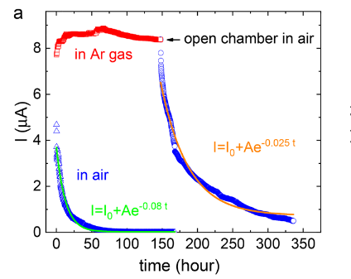

Photoresponse Influences
Environment
Ohmic vs. Schottky contacts
Resistive-capacitive effects
Electronic interactions
Heating
Chertopalov, S. & Mochalin, V. N. ACS Nano 12, 6109–6116 (2018).
Notes:
-Environment: affects stability, drop in current
-Contacts: noise, response speed
-RC effects: affect speed
-Electronic interactions: PV or PC effect
-Heating: thermal effects, PTE effect, BE effect

Slide 11
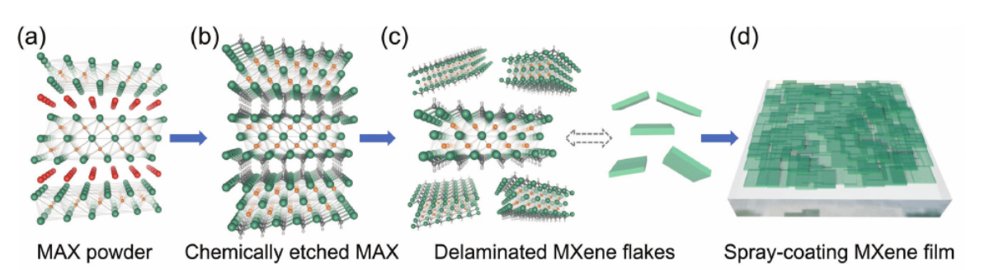
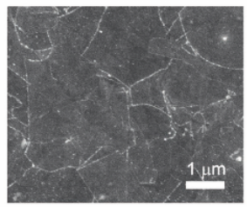


Interflake Interactions for 2D Materials
Schematic
Strong in-plane electronic interactions
Weak out-of-plane van der Waals interactions
Intercalants: molecules situated between two layers
Increase spacing between layers
Contribute to electronic properties
SEM
Wang, Z., Kim, H. & Alshareef, H. N. Adv. Mater. 30, 1706656 (2018).
Notes:
-Most 2D materials have in-plane and out-of-plane interactions
-For MXenes:
-In-plane: intrinsic behavior, charge transport within each individual flake
-Out-of-plane: extrinsic behavior, related to variable range hopping or intercalants

Slide 12
Photoresponse Characteristics
Sign
Shape
Speed
Strength
Notes:
-When analyzing these materials, there are a few things we can look out for in the photoresponse
-This is a sneak peek of the data I will be presenting later, but the four things to look out for are
-For the sake of having a fourth “s” word
-Sign indicates positive or negative photoconductivity
-In this case, sign is the first response of the material – pink curve decreases then increases, so it’s characterized as negative
-Speed: intrinsic or extrinsic quality

Slide 13
Objectives
Determine best practices for optoelectronic characterization of MXenes
Probe effect of external stimuli on photoresponse of MXenes
Understand fundamental mechanisms of MXene optoelectronic behavior
Notes:
External stimuli, such as light and environment,

Slide 14
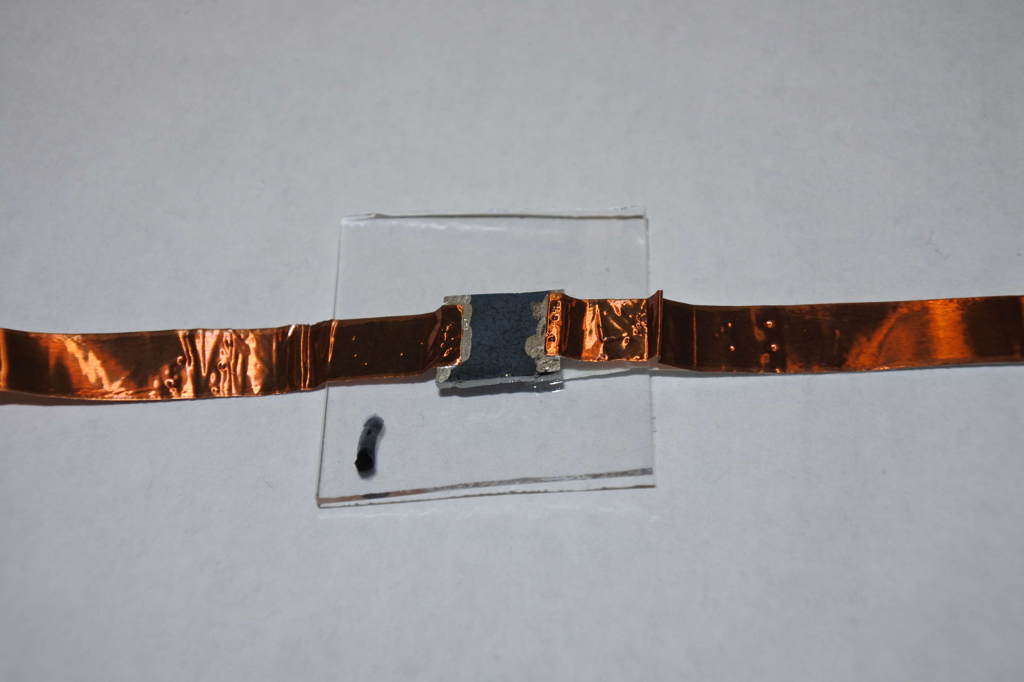
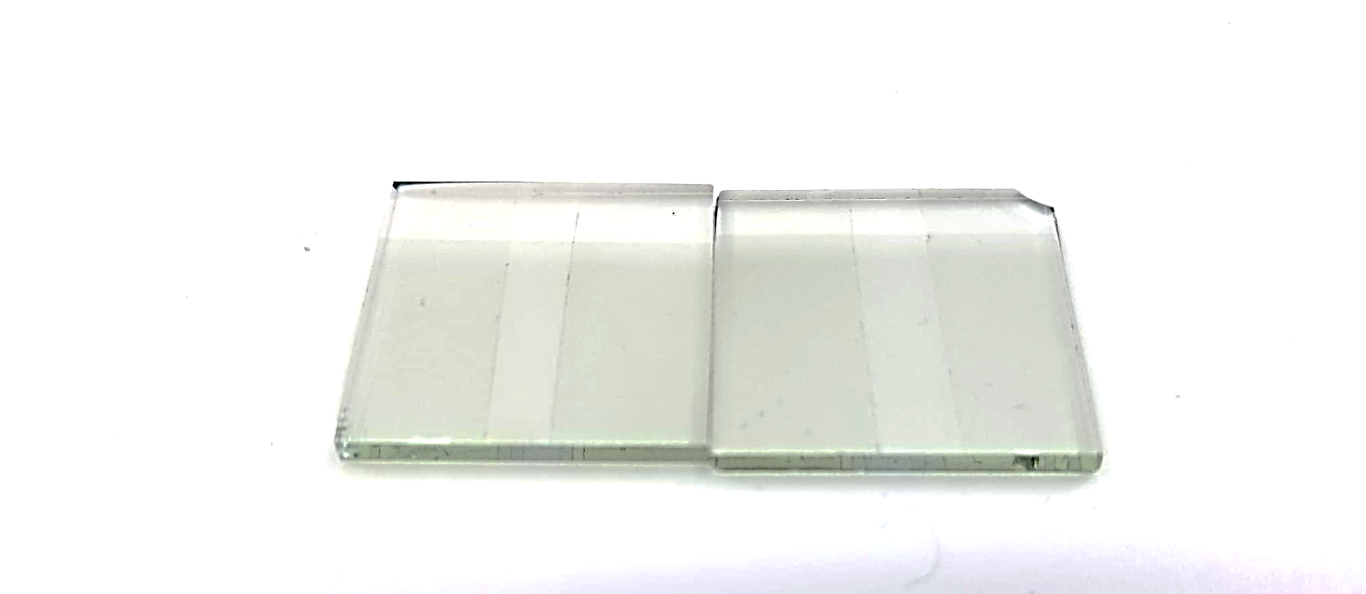
Substrate Types
Pristine Glass Slide
Patterned FTO
2.54 cm
2.5 cm
2.54 cm
2.5 cm
0.5 cm
0.5 cm
Notes:
-Glass slide: microscope slide cut into 0.5 cm square using a diamond pen
-Patterned FTO: etched 0.5 cm channel in the middle of just glass. Depositing the MXene on this substrate allows for an FTO contact, but also allows for the measured resistance of just the MXene, and not the FTO and MXene.
-Substrates were cleaned and treated the same way

Slide 15
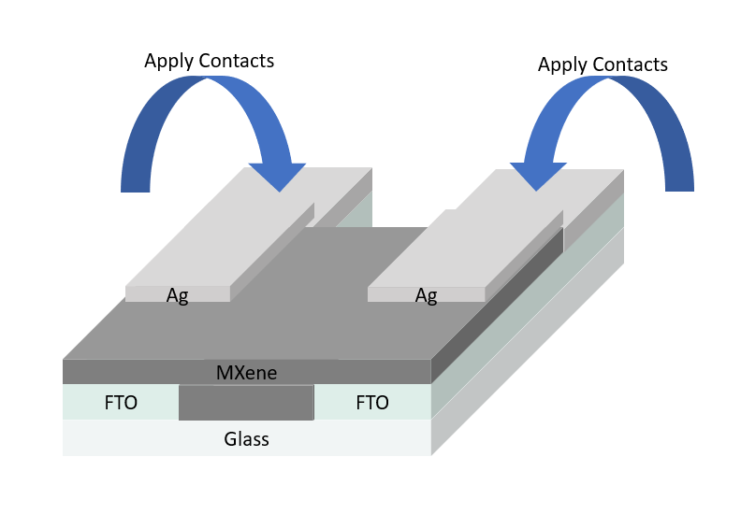
Contact Method
Ag Paint – Cu Tape
FTO or Ag Paint – FTO
Thanks to Dr. Meiping Zhu for generating figure of Ti₃C₂T_{x} contact method.
Notes:
-For pristine glass slides, silver paint and copper tape were used as contacts
-For FTO, either just the FTO was used as a contact or silver paint applied to the top 1 cm of the FTO was used, to test the influence of silver paint on the photoresponse

Slide 16
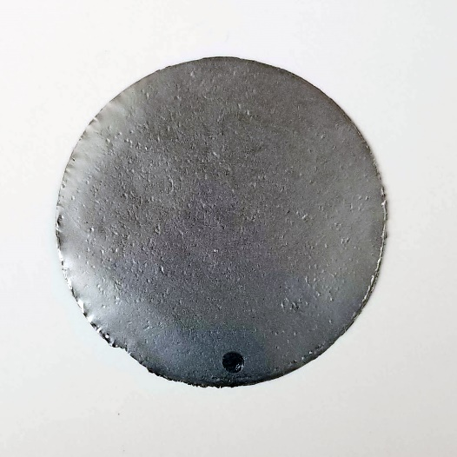
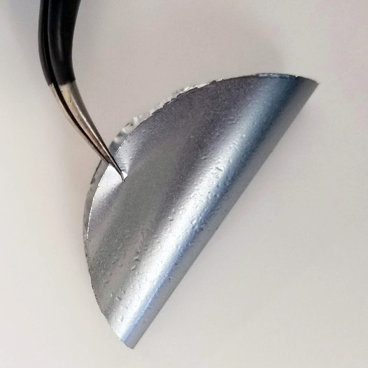
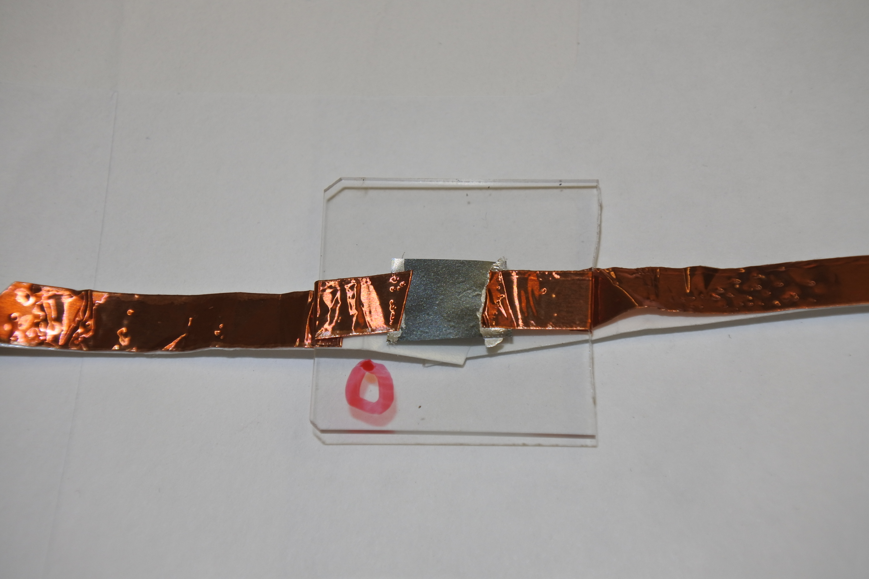
16 μm Free-standing Film of Mo₂TiC₂T_{x}
4 cm
Notes:
-In terms of the MXene, a vacuum filtered free-standing film cut into a 0.5 cm square and was attached to a glass slide using silver paint for testing
-Film lustrous, flexible

Slide 17
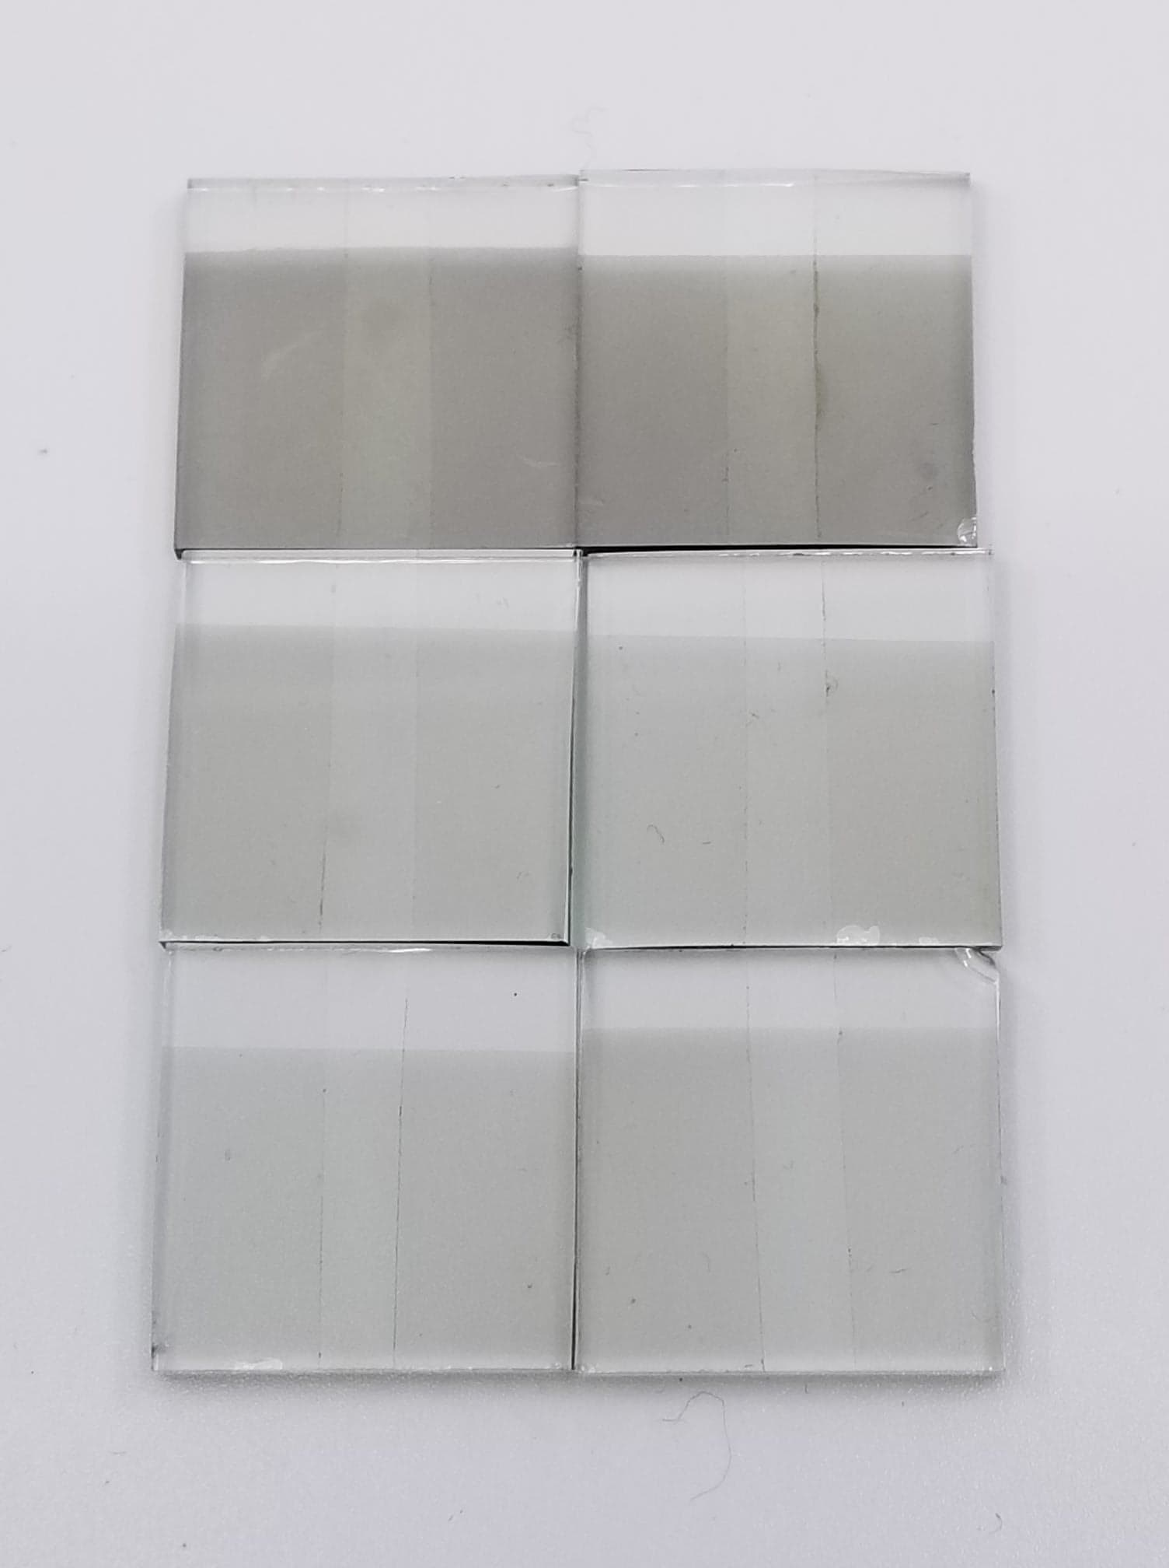
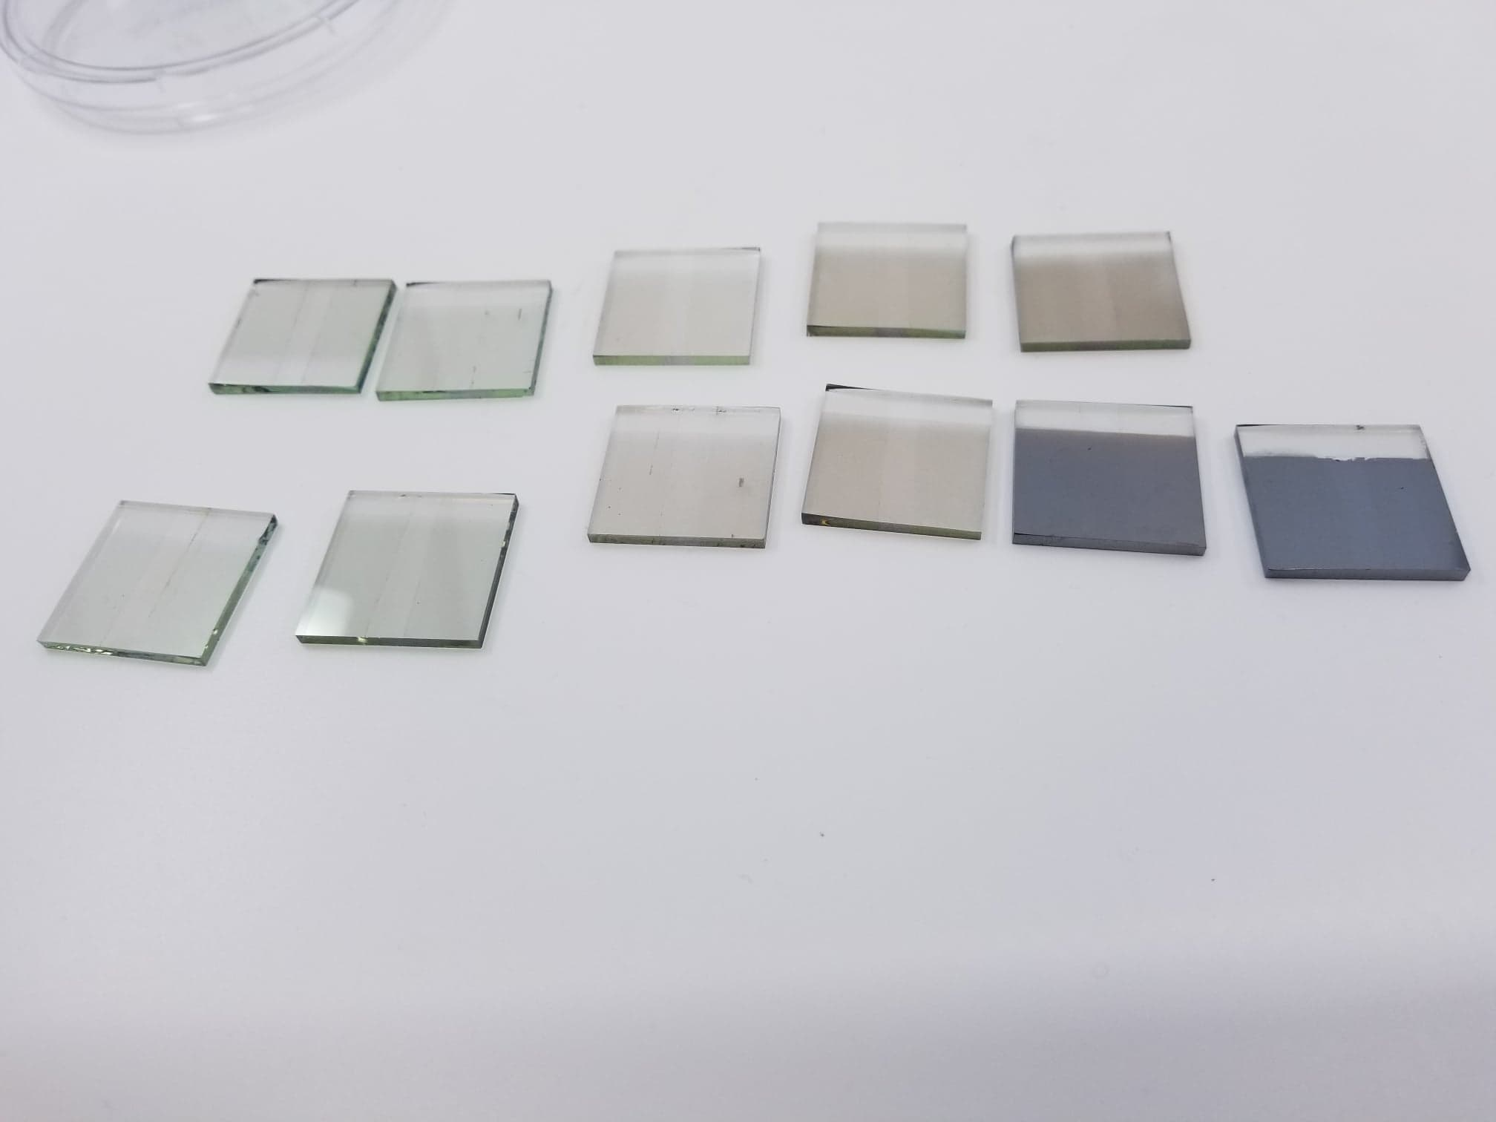
Spray Coating of Ti₃C₂T_{x} and Mo₂TiC₂T_{x}
Ti₃C₂T_{x}
Mo₂TiC₂T_{x}
R₀ < 1,000 Ω
R₀ > 2,000 Ω
Thickness
Initial Resistance
Notes:
-For the rest of the samples, the MXene was spray coated onto the substrates
-Goal was to spray varying thicknesses of films so they had various initial resistances
-Increasing thickness, decreasing initial resistance, indicating the material is more conductive
-More comprehensive study of this material

Slide 18
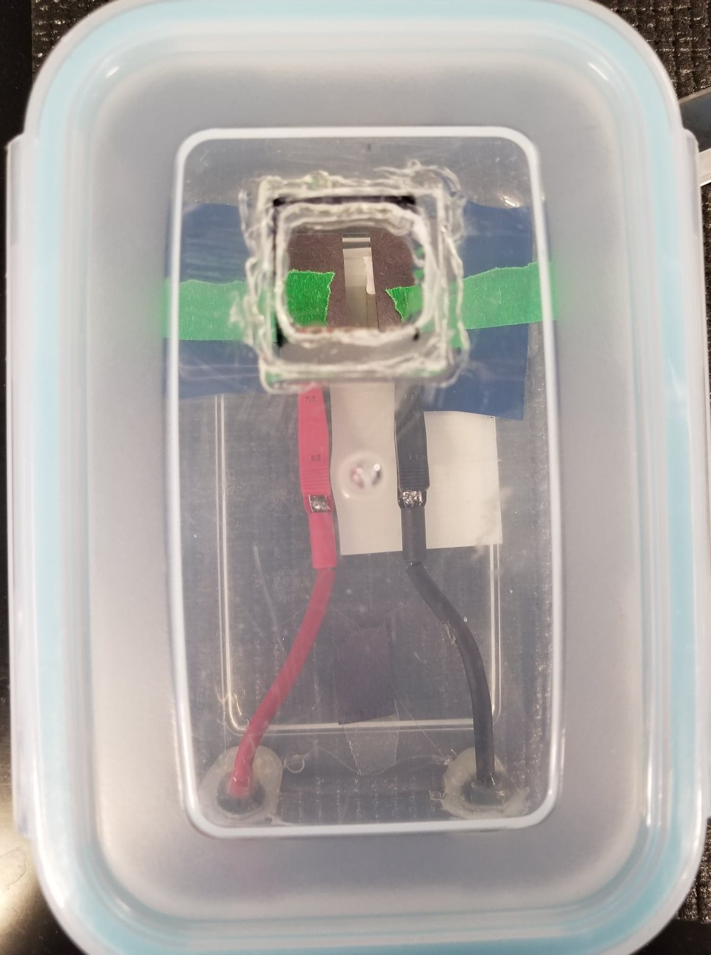
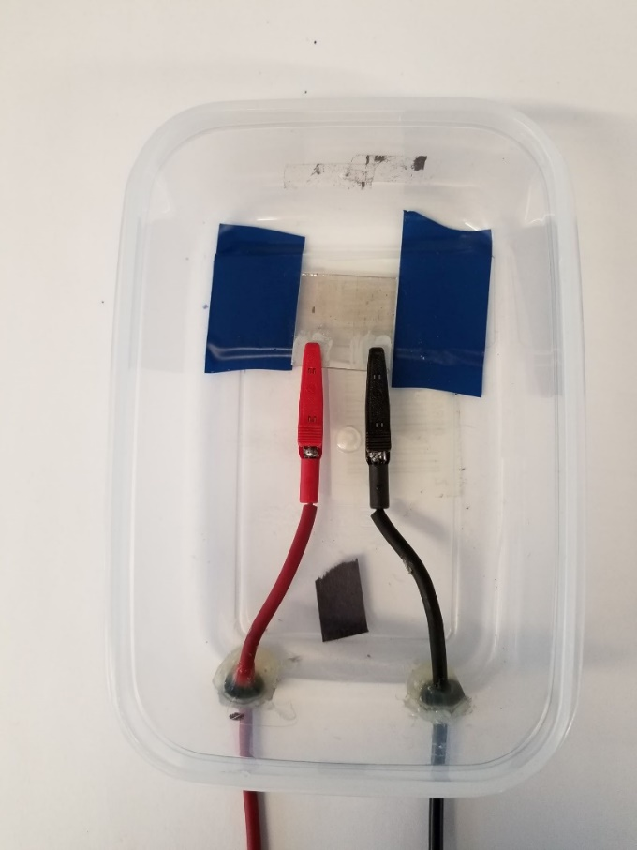
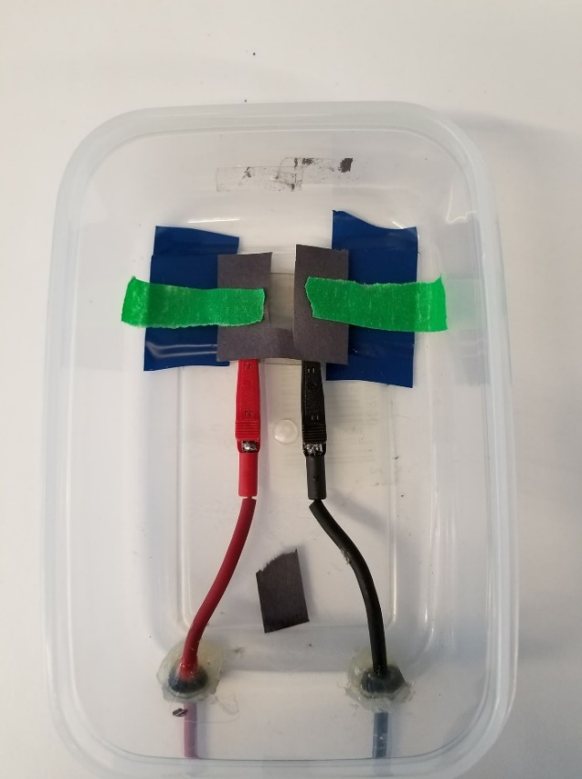
Test Environment with and without Mask
Quartz
Window
Containment Unit
Removal and Application of Mask
Mask
Sample
Electrode
Airtight
Seal
Notes:
-During testing, samples were enclosed in an airtight container to create an inert environment
-Container had a quartz window for light to shine through
-The images on the right show the application and removal of a black paper mask over the inactive area, so over the part of the substrate that isn’t the MXene channel

Slide 19
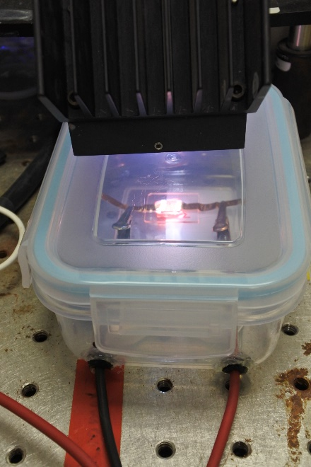
Optoelectronic Characterization
White light
~350 to 800 nm light
0.85 sun intensity
Apply constant current
Measure voltage
Calculate resistance
Chopped illumination
15 s cycles for pristine glass slides
60 s cycles for FTO
Notes:
-Using the photoconductive effect since I applied a constant current
-Chopped illumination to measure the material’s repeated response to 15 s of light off, then 15 seconds of light on for multiple cycles
-For the FTO samples, I used 60 s cycles instead

Slide 20
Data Analysis and Manipulation
Establish baseline using MATLAB
Reduces external influences
Reduces drift
Normalize across all cycles
∆R: difference between maxima and minima around change in cycle
R₀:initial resistance averaged for all cycles
Notes:
-Reduce long-time drift possibly due to environment, heating, etc.
-Allows for better comparison across all cycles

Slide 21
Measuring the Photoresponse of Ti₃C₂T_{x} and Mo₂TiC₂T_{x}
Controlled Variables
Manipulated Variables
Substrate preparation
Light intensity
Spectrum of light
Inert environment
Contact method
Film thickness
Presence of Mask
Atmosphere

Slide 22
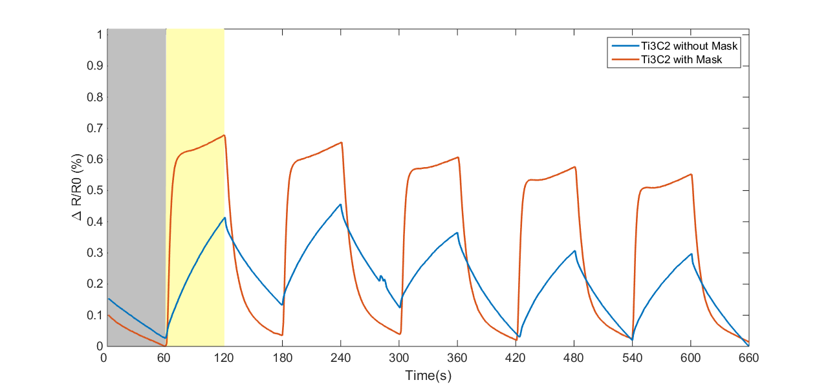


Mask Improves Response of 300 Ω Ti₃C₂T_{x} with Ag
light
off
light
on
Without Mask
With Mask
Notes:
-First, I evaluated the impact of masking the inactive area on the photoresponse
-Upon removing the mask of the inactive area, the photoresponse gets suppressed, as shown by the blue curve compared to the orange curve
-Speed of the response also decreases

Slide 23
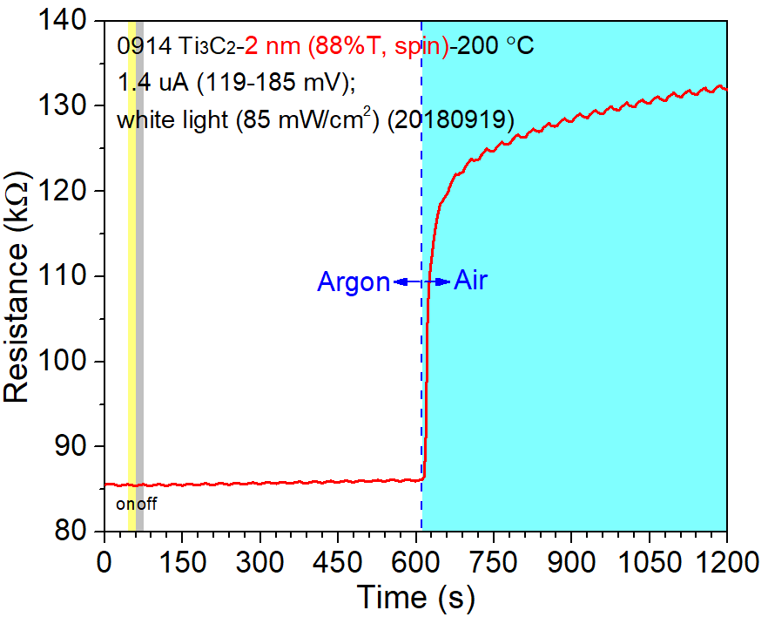
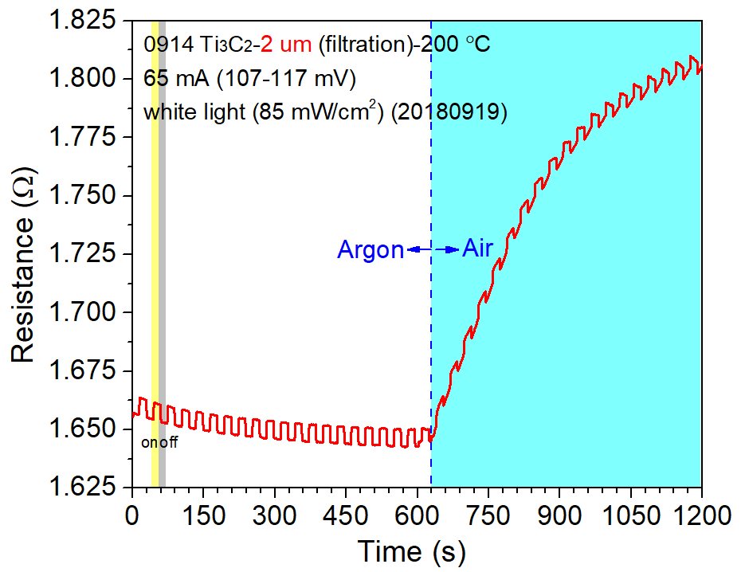
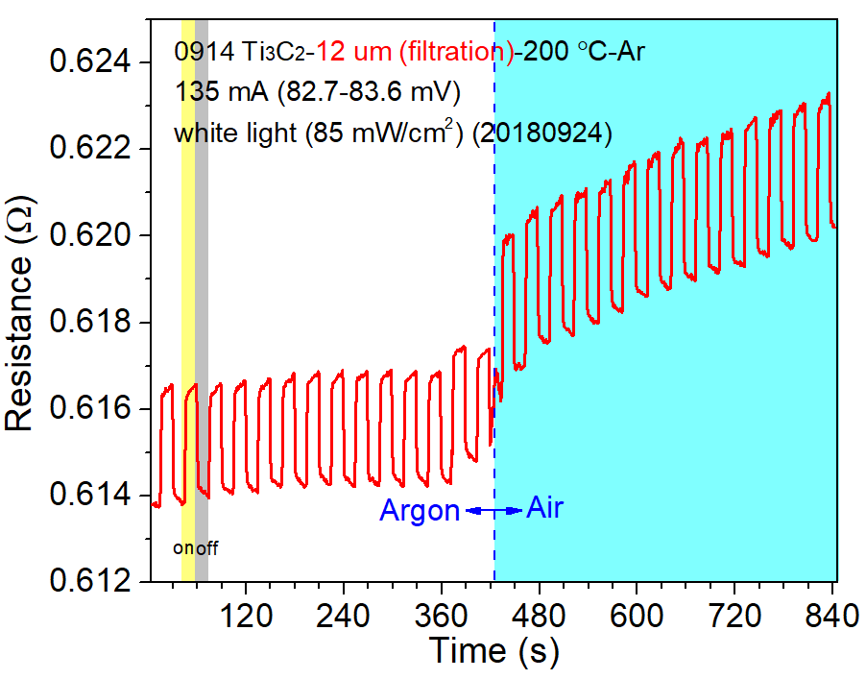
Exposure to Air Increases Resistance of Ti₃C₂T_{x}
R₀ ~ 85 Ω
R₀ ~ 1.66 Ω
R₀ ~ 0.614 Ω
Thanks to Dr. Meiping Zhu for generating figures
Notes:
-Second, I exposed the material to ambient air halfway through optoelectronic characterization
-Because of hydrophilic surface, MXene grabs onto the water in the air and the surface oxidizes, increasing resistance and decreasing conductivity
-Ambient environment destabilizes thinner films the most, as resistance sharply increased for the 2 nm film, but did not increase as much for the 12 um film
-One thing to note here is the characterization continued

Slide 24
Air also Destabilizes R₀ ~ 3,000 Ω Mo₂TiC₂T_{x}
Notes:
-Upon exposing Mo to ambient air, the sample destabilized and could not be optoelectronically characterized further
-Keeping the material in an inert environment during testing prevents water from getting intercalated in this material as well, since previous studies found removing water from between the individual flakes increased the conductivity of the material
-This aligns with previous studies that showed this material is more susceptible to oxidation upon exposure to ambient air than Ti3C2

Slide 25
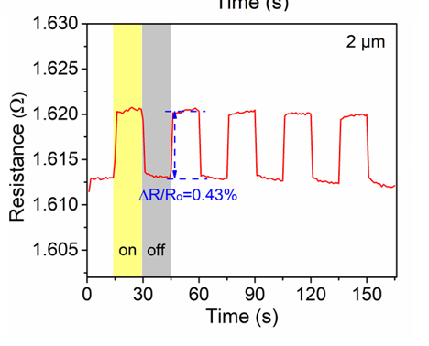
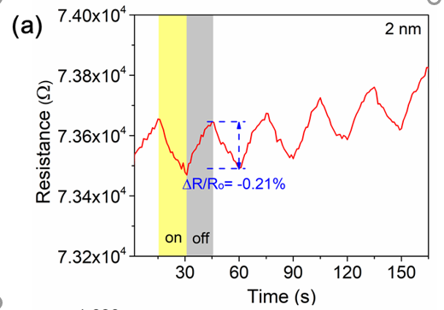






Ti₃C₂T_{x} on Glass Slides with Ag-Cu Contact Experiences Switch in Photoconductivity
Negative Photoconductivity
Positive Photoconductivity
Thanks to Dr. Meiping Zhu for generating figures
Notes:
-I also evaluated the impact of substrate type and contact method on the photoresponse
-Here, Ti3C2 deposited on glass slides showed a switch from negative to positive photoconductivity depending on the thickness
-Gradual response indicates potential extrinsic behavior governs the photoresponse
-Intrinsic response should happen instantaneously

Slide 26
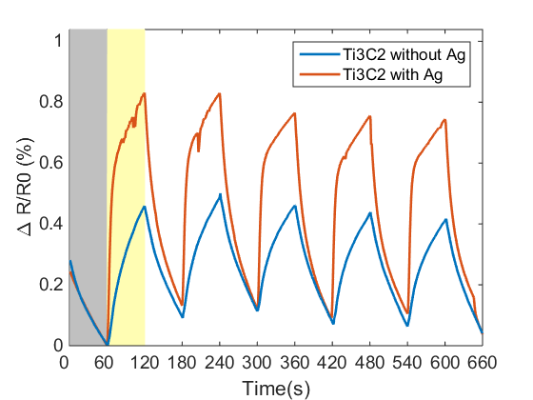
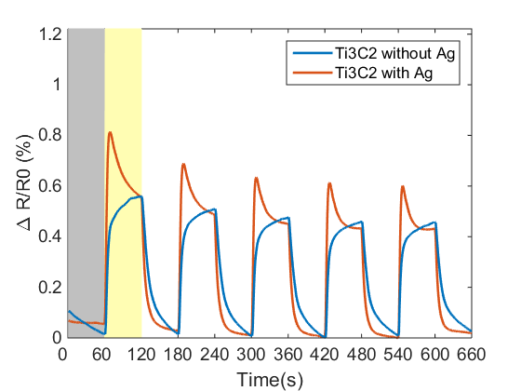
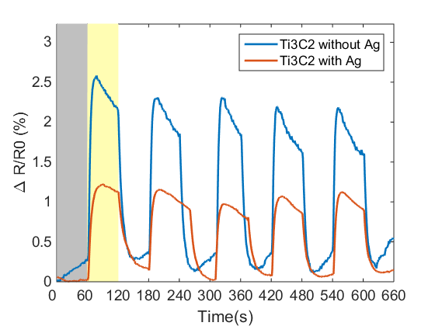
Ag-FTO Contact Influence on Ti₃C₂T_{x} Lacks Consistency
R₀ ~ 260 – 300 Ω
R₀ ~ 800 – 900 Ω
R₀ ~ 2,000 Ω
Notes:
-No consistent influence of Ag, influences shape, strength, and speed, but not consistent across thicknesses

Slide 27
Ag-FTO Contact Switches Photoconductivity of Ti₃C₂T_{x}
R₀ ~ 19,000 Ω
R₀ ~ 45,000 Ω
Notes:
-For thinner films, applying silver caused a switch in photoconductivity, similar to what had happened for Ti3C2 deposited on glass slides
-This switch happens at a different initial resistance
-Interesting note here is the steep decrease in resistance throughout the rest of the light cycle, and increase in resistance upon rest of dark cycle
-While we don’t understand how or why Ag influences Ti3C2, we can now show that there is an effect in the first place

Slide 28
Ti₃C₂T_{x} Experiences Switch in Photoconductivity upon Ag Contact Application
Notes:
-To summarize, Ti3C2 consistently shows negative photoconductivity without Ag application
-Switch on glass slides occurs at 10^2 ohms
-Switch on FTO occurs at around 23kohms

Slide 29
Mo₂TiC₂T_{x} on Glass Slides with Ag-Cu Contact Exhibits Positive Photoconductivity
Notes:
-This figure shows the photoresponse of the free-standing film (red curve) and the thickest spray coated film (blue curve)
-Pseudo-positive photoconductivity for spray coated films, as the response is gradual

Slide 30
Thinner Mo₂TiC₂T_{x} on Glass Slides Exhibit Gradual Positive Photoconductivity
Notes:
-Magnitude of change in resistance increases for thinner films, but response is still gradual

Slide 31
Mo₂TiC₂T_{x} on Glass Slides Exhibit Consistent Positive Photoconductivity
Notes:
-To summarize, Mo deposited on glass slides consistently exhibits positive photoconductivity
-No trend in magnitude depending on initial resistance

Slide 32
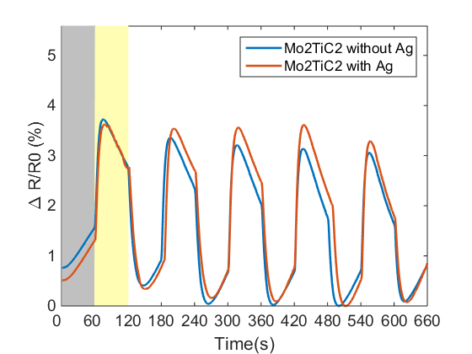
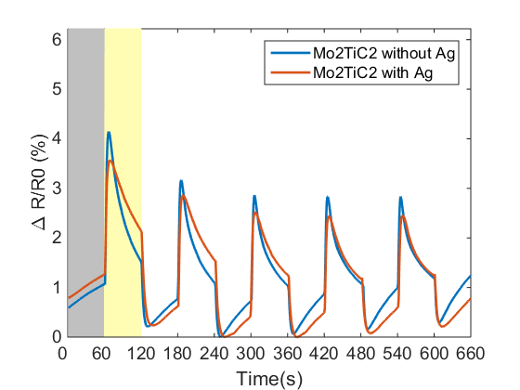
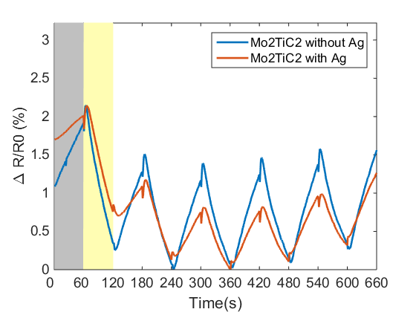
Ag Contact does not Significantly Influence Photoresponse of Mo₂TiC₂T_{x} on FTO
R₀ ~ 120 Ω
R₀ ~ 450 Ω
R₀ ~ 26,000 Ω
Notes:
When deposited on FTO
Something to note here is the shape of the curves with decreasing thickness or increasing initial resistance
The thinnest film of this set – similar behavior to thin Ti3C2, where initial increase then steep decrease

Slide 33
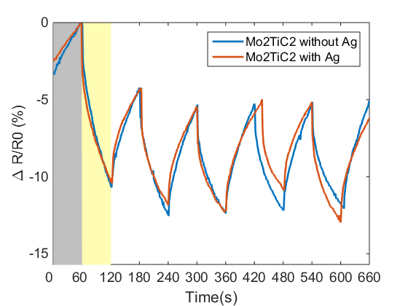
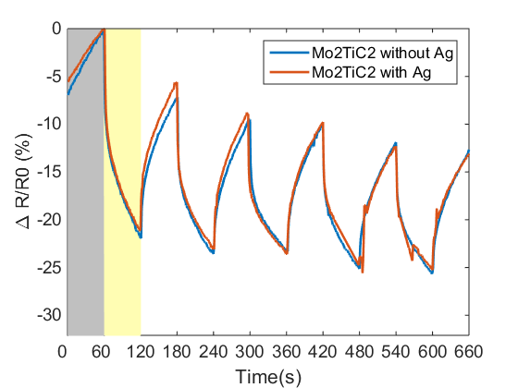
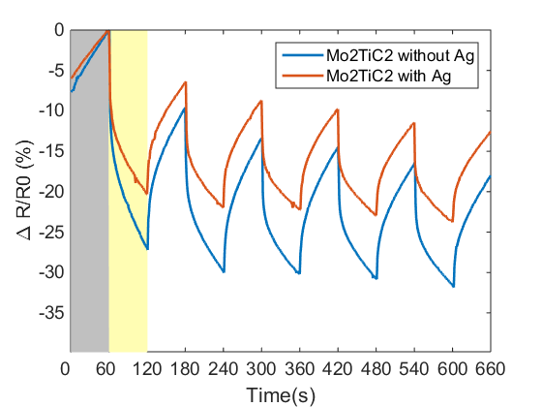
Thin Mo₂TiC₂T_{x} Films on FTO Exhibit Consistent Positive Photoconductivity
R₀ ~ 320,000 Ω
R₀ ~ 1,420,000 Ω
R₀ ~ 1,450,000 Ω
Notes:
For thinnest films of the sample set, exhibited positive photoconductivity
Again, Ag didn’t significantly influence photoresponse, but suppressed response for the thinnest sample

Slide 34
Contact Method Determines Measured Photoconductivity of Mo₂TiC₂T_{x}
Notes:
-To summarize, Mo exhibits switch from negative to positive at around 300k Ohm
-For this material, substrate matters, application of Ag contact doesn’t have as much of an influence
-While we don’t understand why this switch occurs, at least these results somewhat align with previous studies
-Free standing films thermoelectrically showed metallic behavior
-Spray coated films showed positive photoconductivity

Slide 35
Mo₂TiC₂T_{x} Experiences Larger Change in Resistance than Ti₃C₂T_{x}
Notes:
-When compared to Ti3C2, the material exhibits a switch at a different initial resistance
-Magnitude of the change for Mo is larger than that of Ti3C2
-Mo is better as a photoabsorber, Ti is better as contact

Slide 36
Mo₂TiC₂T_{x} Shows Increase in Resistance Change with Decreasing Thickness
With Ag Contact
Without Ag Contact
Notes:
-Overall, Mo experiences a switch from negative to positive regardless of Ag application
-Strength of the photoresponse seems to rely on the initial resistance for the most part

Slide 37
Ti₃C₂T_{x} Photoresponse Lacks Trend with Decreasing Thickness
With Ag Contact
Without Ag Contact
Notes:
-Not the case for Ti3C2
-No consistent trend in strength of photoresponse (green curve at the top)
-However, applying Ag causes a switch in photoconductivity from negative to positive for thinner films, shown in the figure on the left but not for the figure on the right

Slide 38
Conclusions
Best practices:
Mask inactive area during optoelectronic characterization
Use patterned FTO or other transparent conducting oxide as contact method
Maintain inert environment
Ti₃C₂ (without Ag contact): negative photoconductivity
Mo₂TiC₂: switch from negative to positive photoconductivity

Slide 39
Future Work
Probe intrinsic optoelectronic behavior of free-standing films
Measure wavelength-dependent photoresponse of Mo₂TiC₂T_{x} to verify positive photoconductivity
Utilize terahertz spectroscopy to disentangle thermal and electronic influences
Vary substrates to aid in heat transfer

Slide 40
Questions?

Slide 41
Thank you!

